Slide 1
RAID Levels (0,1,5,10)
CTEC 305
Genesis Grant

Slide 2

What is RAID?
RAID – Redundant Array of Independent Disks
Used to prevent storage device failure (not a replacement for regular file backups)
Speed up access to storage devices
Combine multiple storage devices into a single volume

Slide 3
RAID 0
Striping
Divides files into sections and saves them on multiple storage devices
Helps to speed up storage device access
*Not fault tolerant

Slide 4
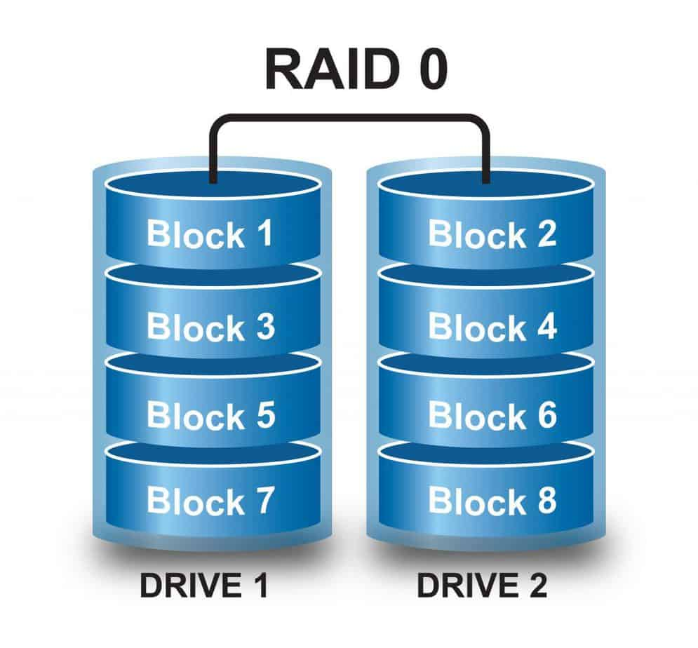
RAID 0

Slide 5
RAID 1
Mirroring
Same data is written to 2 separate storage devices at the same time
Both devices will have identical data
If one fails, copy automatically replaces failed storage device

Slide 6
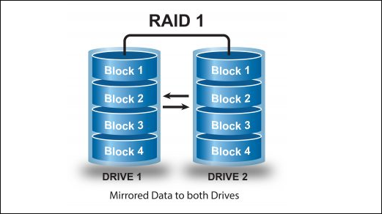
RAID 1

Slide 7
RAID 5
Striping with parity
Replaces RAID levels 3 & 4; most commonly used RAID configuration today
Requires minimum 3 storage devices
Parity info not stored on separate devices but is mixed with data on the storage devices
If device fails, data on other devices can regenerate lost info
After replacing failed device, data can be easily rebuilt
Offers better performance and fault tolerant

Slide 8
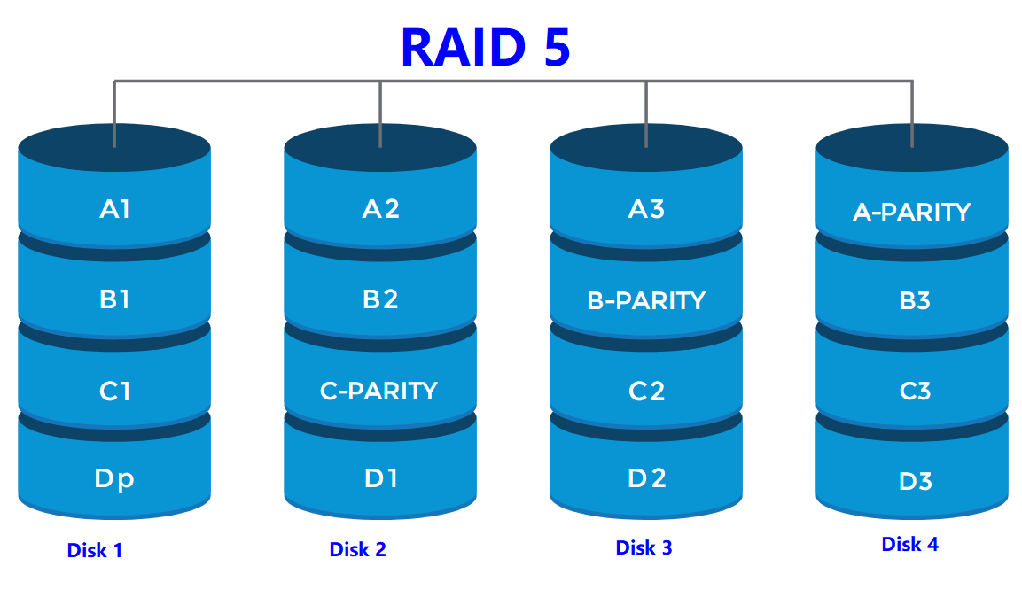
RAID 5

Slide 9
RAID 10
Mirroring & Striping
Combines RAID 0 & 1
Set of 2 disks are mirrored, then both are striped
Minimum 4 disks
Benefits from RAID 1 fault tolerance & RAID 0 speed
Can only use 50% storage space for data storage

Slide 10
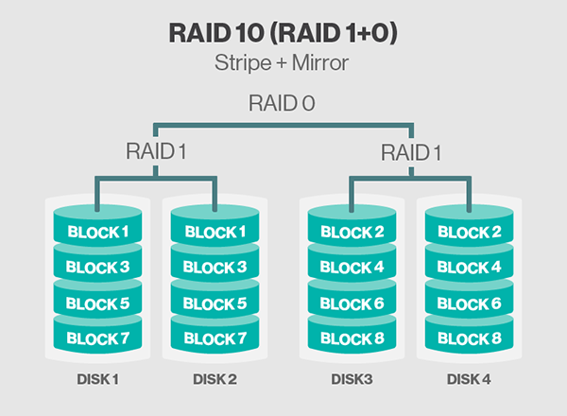
RAID 10

